Slide 1

PYTHON PROGRAMMING LABORATORY
TOPIC : CHATBOT
ABHISHEK M M
4VV20IS002

Slide 2
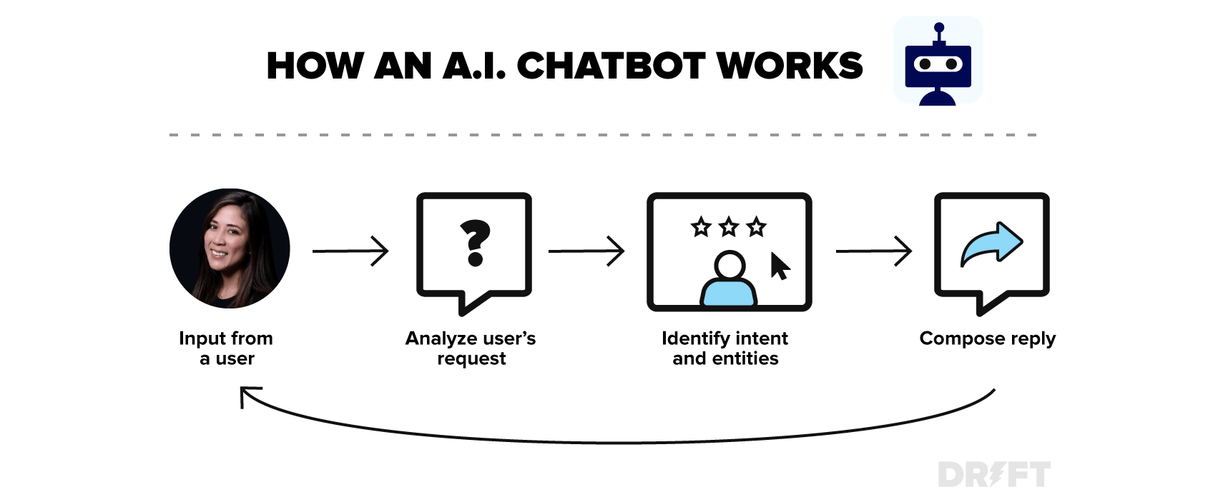

Slide 3

TOOL USED : GOOGLECOLAB
Google Colab is a free cloud-based service that allows the execution of Python code using the Jupyter Notebook format.
It is possible to use and install new python libraries.
Colab offers GPU (Graphics processing unit) as well as TPU (Tensor processing unit)
A web IDE for python, Which enable Machine Learning with storage on the cloud

Slide 4
PACKAGES USED
Natural Language Toolkit:
It provides us various text processing libraries with a lot of test datasets. A variety of tasks can be performed using NLTK such as tokenizing, parse tree visualization, etc…
import nltk
from nltk.stem import WordNetLemmatizer
nltk.download('popular', quiet=True) # for downloading packages
def LemTokens(tokens):
return [lemmer.lemmatize(token) for token in tokens]
remove_punct_dict = dict((ord(punct), None) for punct in string.punctuation)
def LemNormalize(text):
return LemTokens(nltk.word_tokenize(text.lower().translate(remove_punct_dict)))

Slide 5
NumPy
In Python we have lists that serve the purpose of arrays, but they are slow to process. NumPy aims to provide an array object that is up to 50x faster than traditional Python lists.
import numpy as np
Random
Python Random module is an in-built module of Python which is used to generate random numbers.
Import random
greet= ["hi", "hey", "*nods*", "hi there", "hello", "I am glad! You are talking to me"]
a= random.choice(greet)

Slide 6
THANK YOU

